Slide 1
Outstanding teaching and Learning
Resource bank

Slide 2
Independent learners, what do they look like? ( Jill William)
They make decisions
Confident to question
Motivated to take risks
Revisit tasks/questions without being asked
Take initiative
Balance the expectations of others
Take some responsibility for creating, organising and maintaining the learning environment
Confident to seek help
Bring personal experiences to the task

Slide 3
Golden rules for supporting literacy in any classroom
Talk the talk, so they can walk the walk (sloppy speech will only produce sloppy writing)
Provide scaffolding for talk
If they can say it, they can write it
Good writing is a construct, without any scaffolding it will fall apart
Assess for content And literacy

Slide 4
Mind sets- Know what you are dealing with and try to develop open mind sets
Open (growth) Mind-set
Closed mind-set
Pupils enjoy challenge
Like taking risks
Accept failure
Try tom improve
Like learning in different ways
Like finding their own solutions
Enjoy the leaning journey
Know what they are good at
Don’t like failure
Will not take risks
Wont try if they think they will fail.
Like to learn in a particular way.
Don’t like change and challenge.

Slide 5
Getting them thinking
‘Engaging the emotional brain makes your class curious and attentive’ Jackie Beere
Thunks
Getting into the pit , and out again together ( see slide 19)
Curiosities
Creative challenge
Work for, party with, or send to the jungle ( pupils given three people, places, elements, to choose from)

Slide 6
Split screen lesson objectives
Have the objectives on one side and the skills being developed on the other.

Slide 7
“Treasoning!”

Slide 8
TREASONING!
It helps you verbalise/write:
Well structured and coherent arguments
With a sharp focus on title question/task
Consider different ideas and interpretations, and the strength of your arguments

Slide 9
How to understanding...
“Treasoning!”
The point you are making is the main part of the tree.
The “wind” is the arguments against your point
The “roots” are the quotes, and reasons, to support the point you are making

Slide 10
is useful because in essays you must...
“Treasoning!”
The point you are making is the main part of the tree.
Ensure the point you are making is the central focus of that paragraph!
You must consider other arguments and perspectives.
The “wind” is the arguments against your point
The “roots” are the quotes, and reasons, to support the point you are making
You must always show in your essays what support you have for your points through your ideas and quotes!

Slide 11
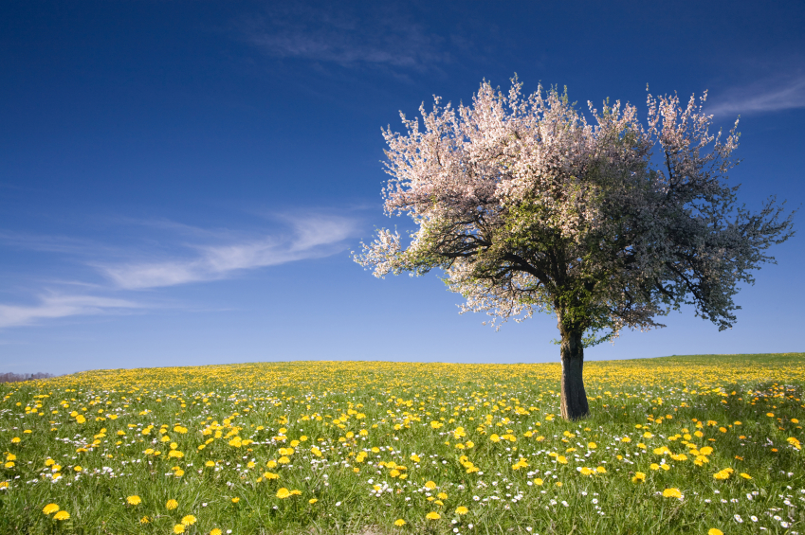
TREASONING!
Writing conclusions: which points are most supported? Which have more arguments against?
I.e. is your tree left standing?

Slide 12
BLOB TREES
Pupils consider the type of learner they are in your class my circling blobs most like them.
Ask questions such as “which would you most want to be?” “Why?” “How can you become this blib here?”

Slide 13
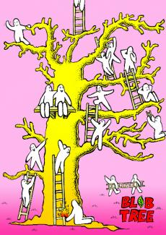

Slide 14
SKILLS WALL BUILDING

Slide 15
Build a “wall” in your book of important skills needed today.
By the end of the lesson you will have knocked down your wall!
Let’s feedback, add other peoples’ bricks to your wall!
Who can build the biggest wall?
For example...

Slide 16
Re-read your work. What “bricks” can be knocked down? If met, cross them off!
If not, write target next to them!

Slide 17
4 things you can take form today’s lesson!
TAKE 4
Used?
1
2
3
4

Slide 18
To generate curiosity, and encourage independent thinking...use formula connectors!
If ABC = ABD
Finish this MNO=MN?

Slide 19
“The pit” should occur in you lesson...
clarity
confusion

Slide 20
Role reversal
Give students two real exam answers
One at A* and one at B or C
Get them to mark them without knowing the mark.
Write WWW and EBI
Show pupils the marks and grade
Ask them what they have learned.

Slide 21
Question Quadrant
The answer is in the book (comprehension) | Use Your imagination ( Speculation)
Ask and expert (Factual questioning) | You really have to think about it Enquiry
Phil Cam’s 20 Thinking tools-2006

Slide 22
Leadership roles
Pupils are given cards with their role for the lesson (these can change each lesson) at the end, or at point in the lesson, ask them to check on progress for their area.
Do they have any questions for the teacher?
Have they seen evidence of their given area in the lessons?
Can they suggest any improvements?

Slide 23
Leadership cards
Growth Mind-set Monitor
Literacy Monitor
Numeracy Monitor
Progress monitor
Skills monitor
Risk monitor

Slide 24
Question maps
At the centre have the lesson tile or lesson objectives.
Around this have questions and task that pupils can do.
Each task has points, 2, 5 or 10 and these vary in challenge using Blooms.
Pupils work in pairs or groups and have a set time to get as many points as they can.
You can include compulsory questions.
Each person in the group, must have the answer written down, then you can tick their sheet.
Highest points wins.

Slide 26
Back to Back questioning
Pupils given a stimulus ( text, image or video)
Give them time to process it.
With white boards or paper.
Get pupils to stand or sit with their back to each other.
As a question, that each person answers.
They then turn and compare, and decide which is better and why.
Questions increase in challenge using Blooms.

Slide 27
References
The Perfect ofsted lesson. J Beere 2012
Will Ord- Thinking Education
20 Thinking tools. P Cam 2006
Mindset: How You Can Fulfill Your Potentia'l: Carol S. Dweck
Promoting independent learning in the classroom. Jill William 2003

