Slide 1

Featherstone High School
Southall Middlesex
Mixed Comprehensive 11-18 (1500 on roll)
Specialist Sports College with Applied Learning as a Second Specialism
Leading Edge (Use of data)
ICT Mark (800 wireless devices)
Capita Partner

Slide 2

Featherstone high School
41% Indian 21% Somali
15% Pakistani
36% Free School Meal
KS2 Av Pt score 24.5 -25.9
71% English not first language
Deprivation indicator 0.43 (bottom 20%)
Stability 85%
5+A*-C 53% 5+A*-C 80% CVA = 120-140 4yrs

Slide 3

Initial: Aims
Information about each child at your finger tips
Information about the progress of every child in every subject every term
To provide an interpretation of the progress made that could be understood
To provide frequent easy access to this information
to every one
To ensure parents are feel fully informed about the progress of their child
Provide this data on-line (2009)

Slide 4
Reporting On-line: engaging parents
SIMS system set up in 2007
Initially Reported 2 times per year
Now 5 times for yr 11-13
3 times for others
SIMS learning gate way started Sept 2009
All parents provided with logins
Video support in community languages CLICK

Slide 5

Achieving our Aims
Make full use of
SIMS Assessment suite
Attendance
Lesson monitor
Achievement
Behaviour
Assessment
Allow Sufficient time for development
Data Manager to support
All staff trained and have access
Regular contact with other users and SIMS staff

Slide 6
The process
Staff enter data into an interactive mark-sheet
Ks3 levels ks4/5 projected grades
Overall picture seen on each individual report
Reports
Parents have report explained to them during curriculum evenings
Reports extracted from SIMS and made available to all staff on our network
Both tutor and parent familiar with report

Slide 7
Helping parents understand
1 set of reports given out at a curriculum evening
Parents given a presentation by a tutor about the report ( in form classroom)
Report kept simple
Starting point and where they are now
What that progress indicates
Are they on target for where they want to be?
Summary data

Slide 8
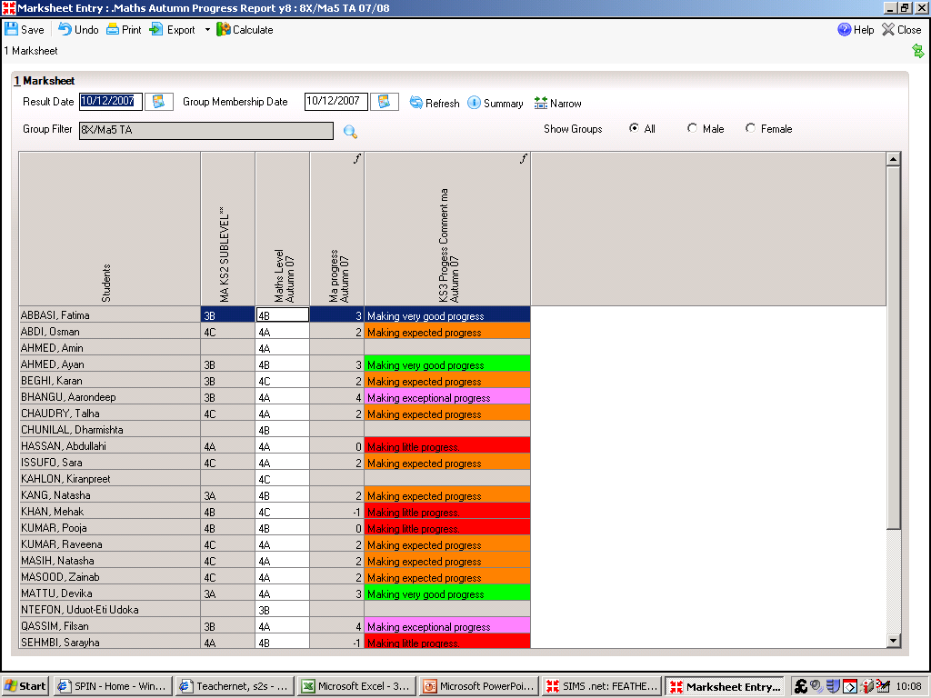
Key Stage 3 Mark Sheet
Student names

Slide 9
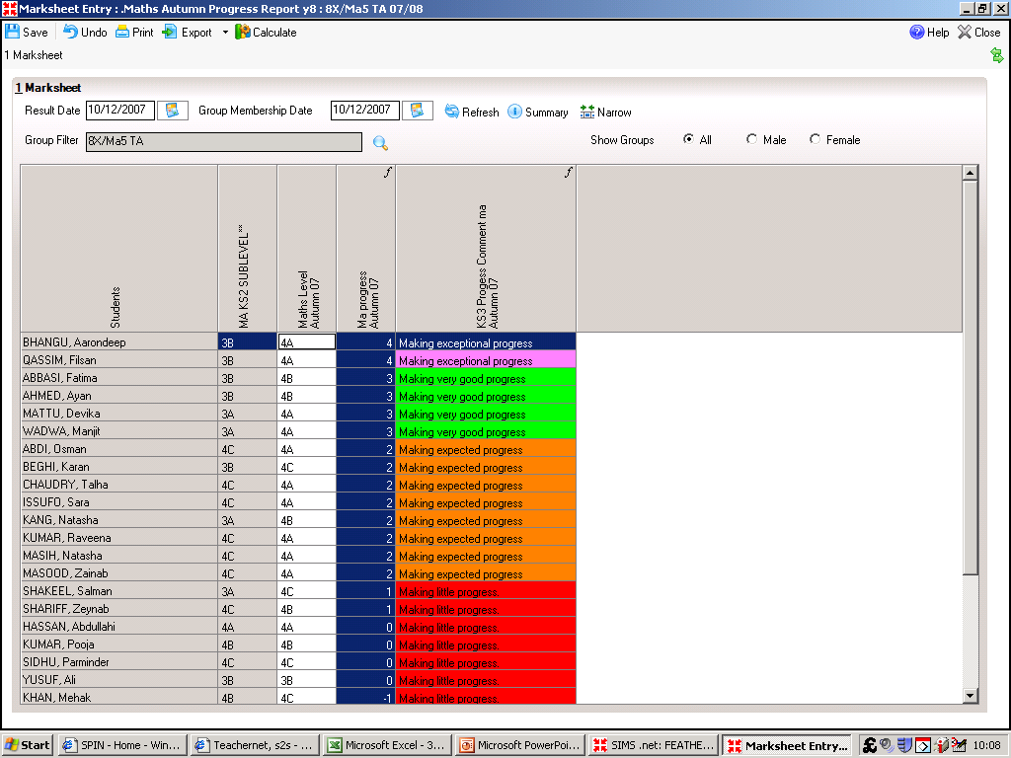
Key Stage 3 Mark Sheet
Student names

Slide 10
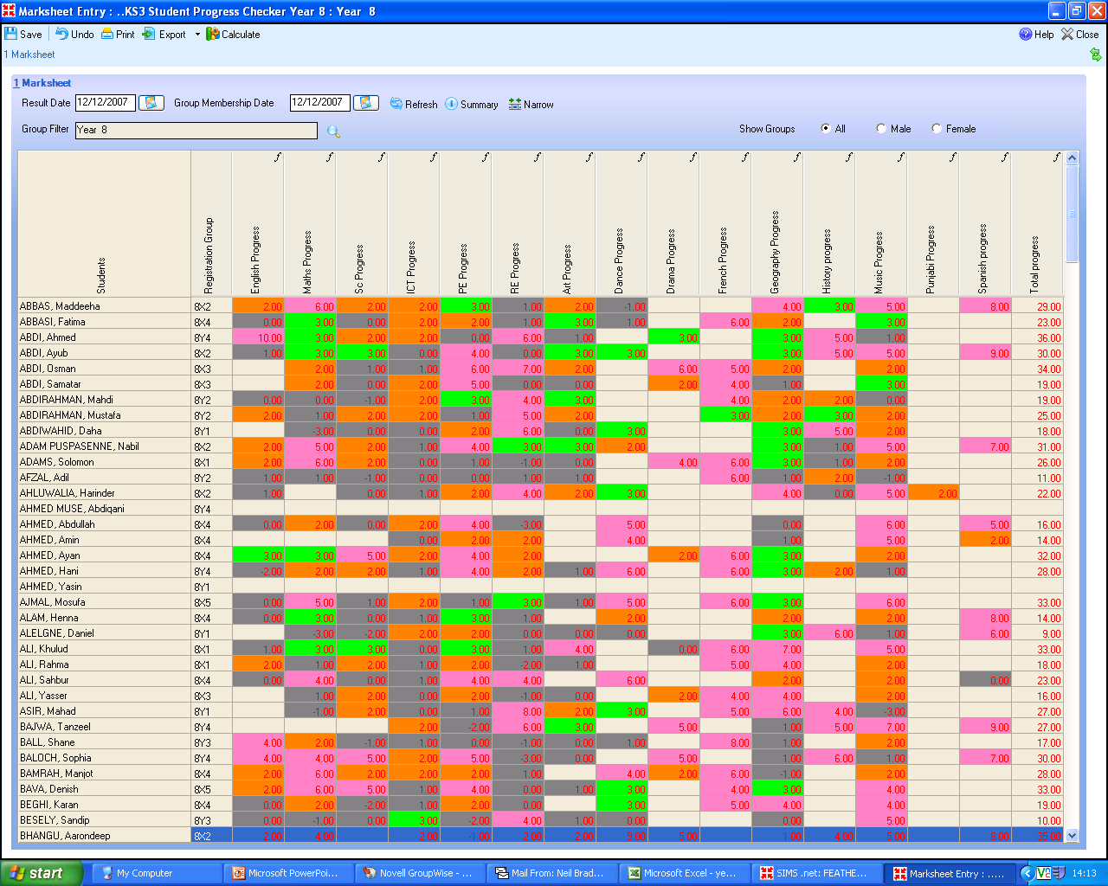
Progress made in Sub levels Colour Coded

Slide 11
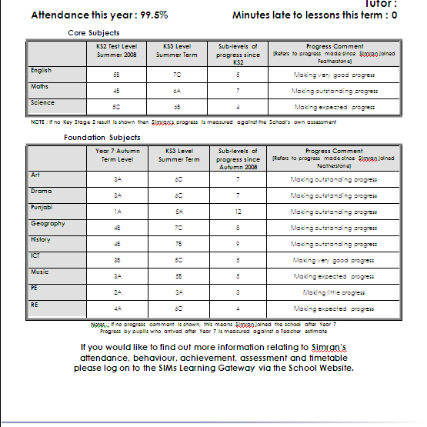
http://screencast.com/t/12p8MN44

Slide 12
Reporting at Ks4
GCSE REPORT
http://screencast.com/t/NoSV1f5ryQQ

Slide 13
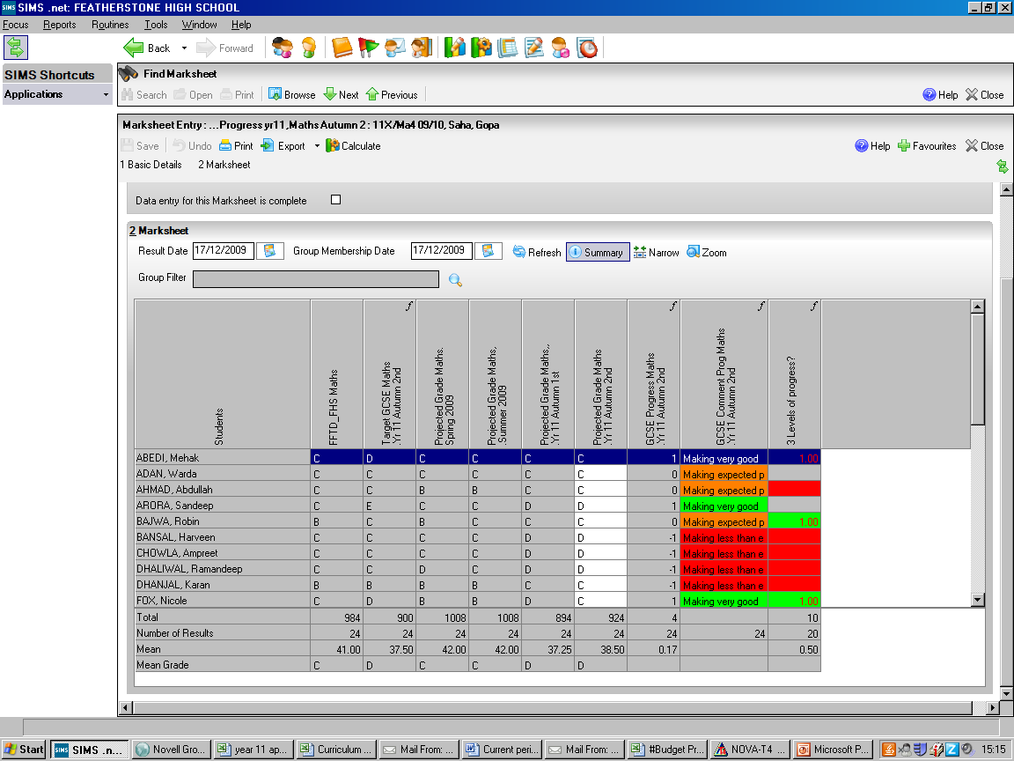

Slide 14
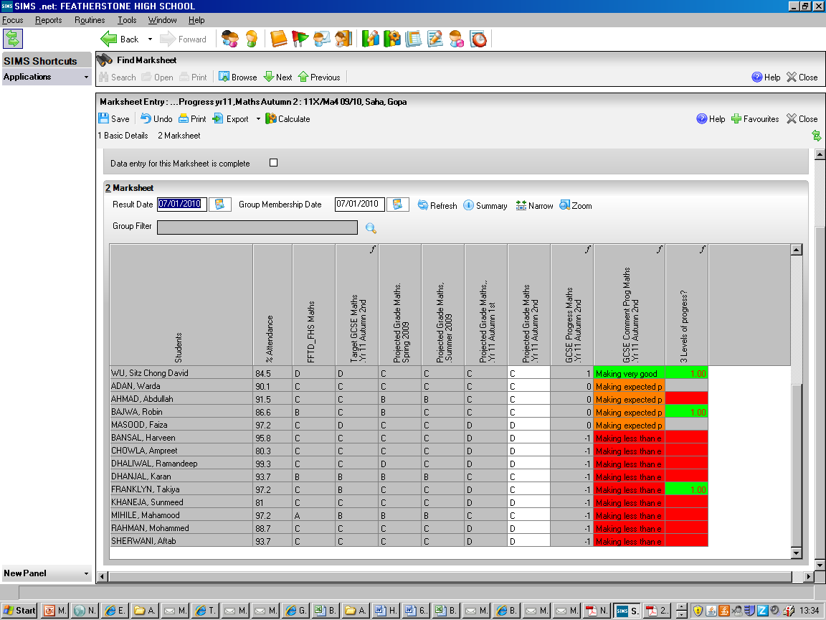

Slide 15
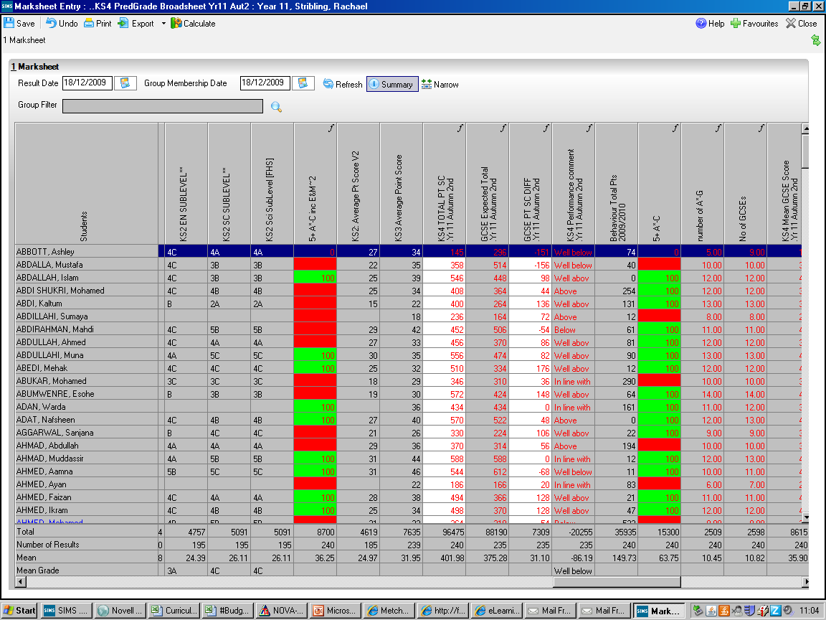

Slide 16
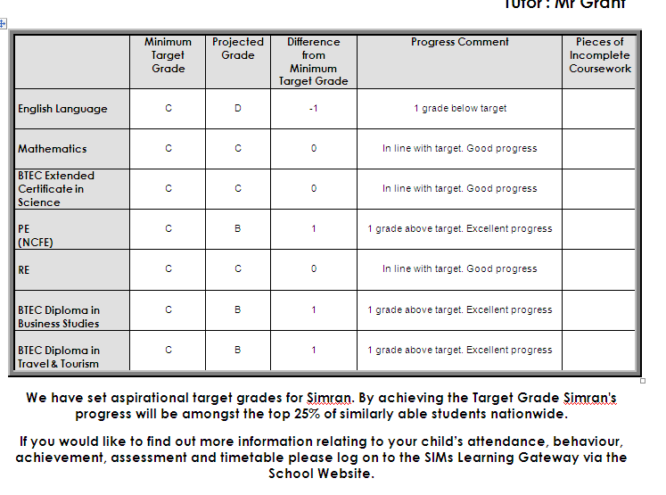
Ks4 report

Slide 17
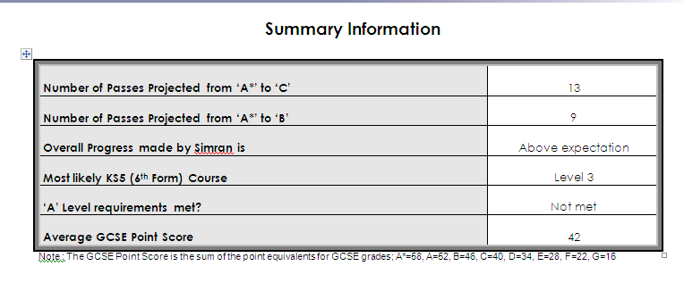
Ks4 Summary information

Slide 18
6th form reporting
ALPS targets
Projected grade
Difference Calculated
Interpretation provided
SIMS can generate an ALPS Score

Slide 19
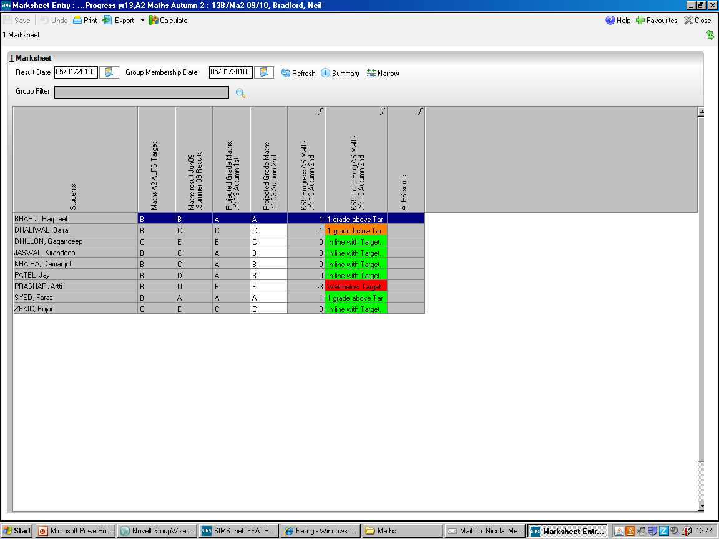
Difference between ALPs Target and Current projected grade
ALPs
Target grade
Current Projected A2 result
AS result

Slide 20
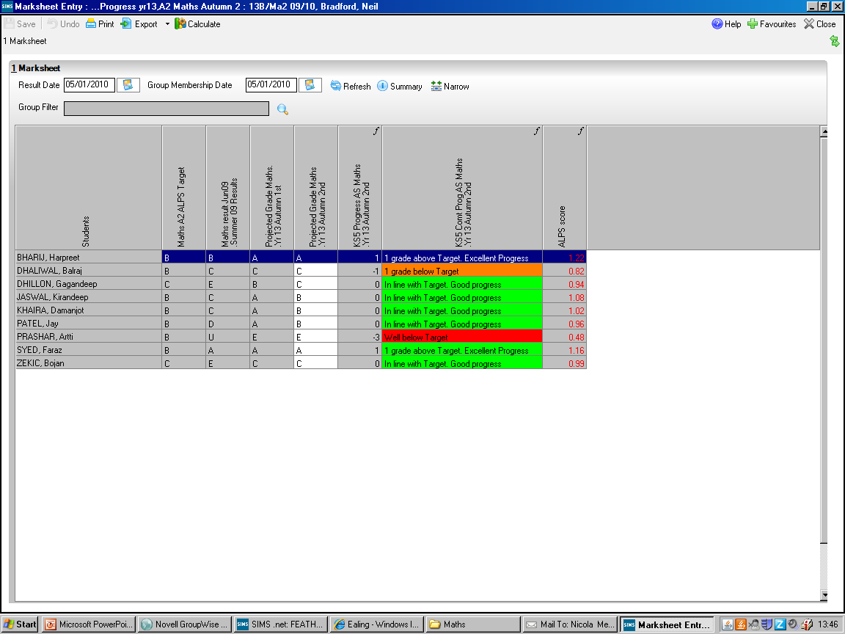

Slide 21
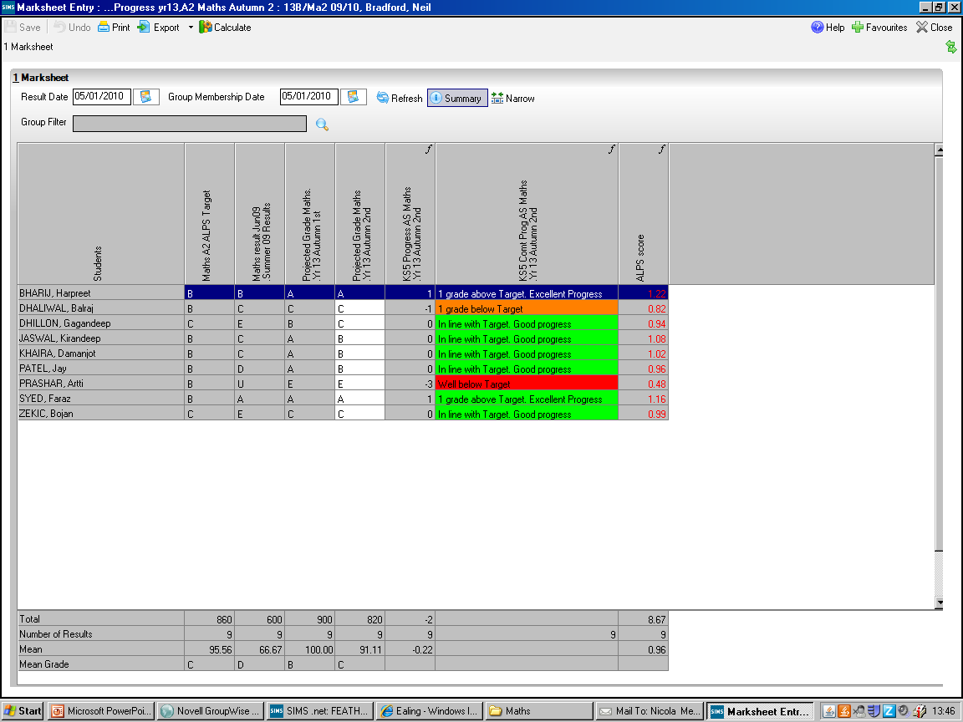
Group ALPs Score

Slide 22
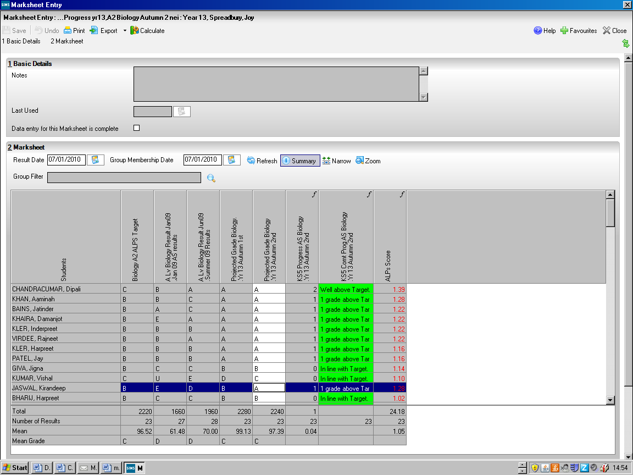
Biology ALPs Score Calculated in SIMs at point of data entry

Slide 23
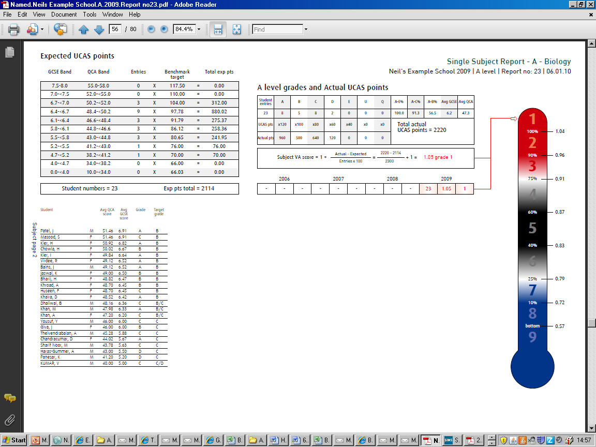

Slide 24
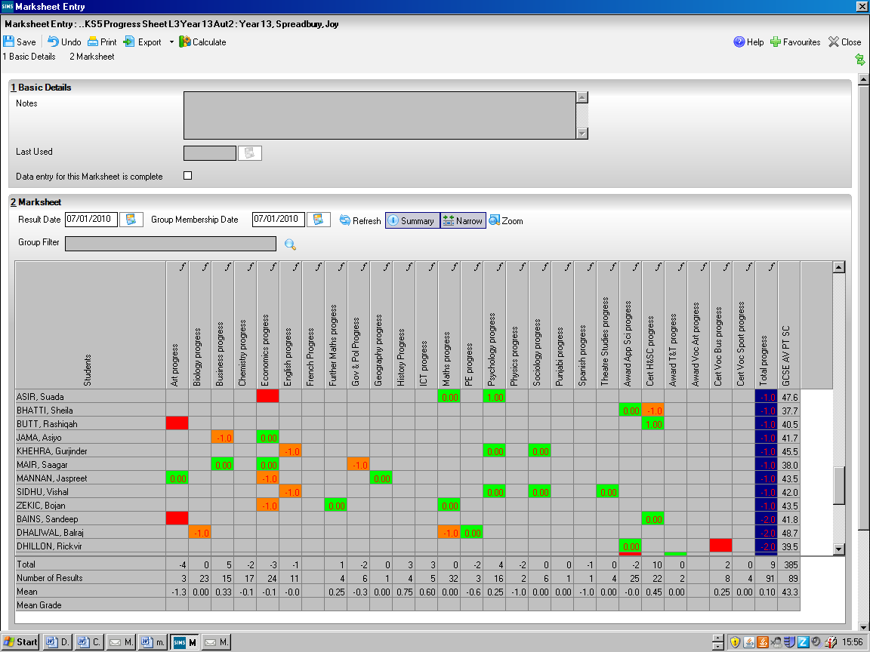
At or above ALPs Target
TLRs 6th Form
1 grade below ALPs Target
>1 grade below alps Target

Slide 25
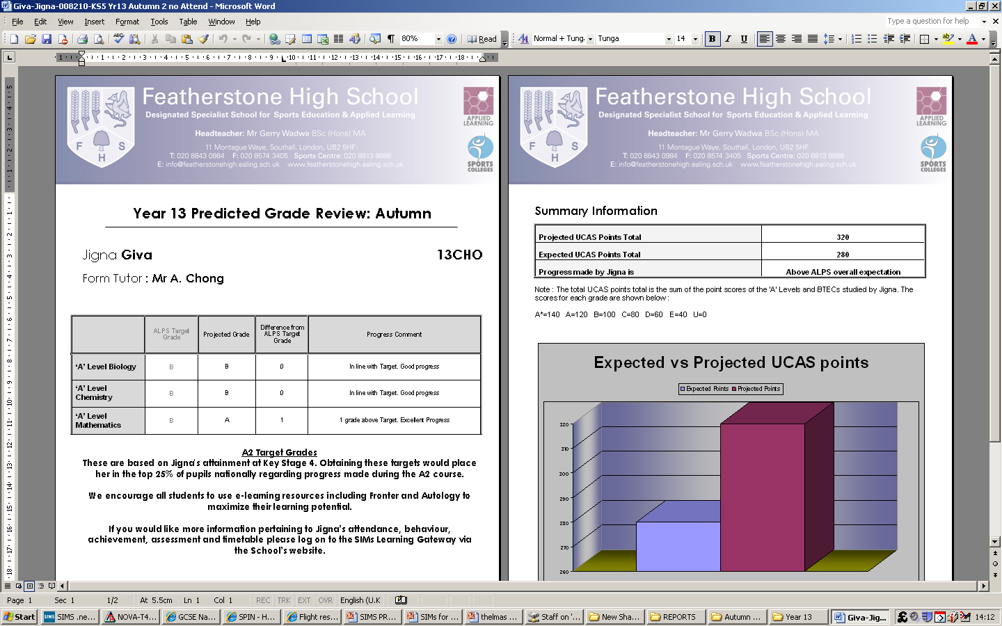

Slide 26
System Issues
Ensuring accuracy of levels/projections
FFTD and ALPS not always appropriate
Parents more informed than tutors
On-line PASSWORD problem

Slide 27
We respond to this knowledge by
Checking data and questioning anomalies before reports are released using assessment suite
Scrutiny of department assessment procedures ( supported by the above)
Raising targets above ALPS/FFTD?
( performance management conflict)
Directed time used to ensure tutors read through reports

Slide 28
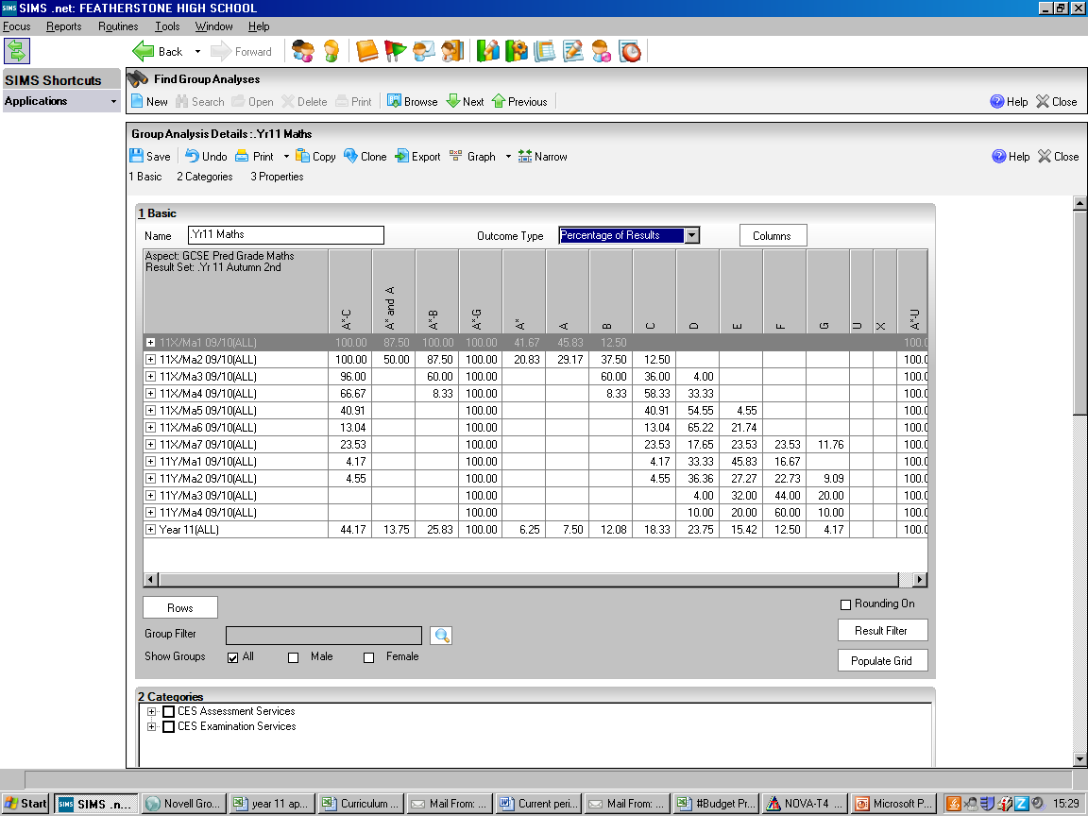

Slide 29
Group
Analysis
Marksheet
Marksheet
Group | Pass | VA | 3+
x1 | 100 | 0.8 | 100
x2 | 100 | 0.8 | 100
x3 | 96 | 0.4 | 78
x4 | 67 | 0.2 | 50
x5 | 41 | 0.1 | 60
x6 | 13 | 0.4 | 50
x7 | 24 | 0.0 | 33
y1 | 5 | 0.8 | 61
y2 | 4 | 0.7 | 33
y3 | 0 | 0.6 | 23
y4 | 0 | -0.4 | 0

Slide 30
Group | Pass | VA | 3+
x1 | 100 | 0.8 | 100
x2 | 100 | 0.8 | 100
x3 | 96 | 0.4 | 78
x4 | 67 | 0.2 | 50
x5 | 41 | 0.1 | 60
x6 | 13 | 0.4 | 50
x7 | 24 | 0.0 | 33
y1 | 5 | 0.8 | 61
y2 | 4 | 0.7 | 33
y3 | 0 | 0.6 | 23
y4 | 0 | -0.4 | 0

Slide 32
Changes for 2012
Changes for 2011-2021
Baccalaureate Yes/NO
Expected progress in Eng Maths Yes/No
School reports replacing assessment aspects
Report keeps parents aware of changing educational landscape

Slide 33
Impact
Common understanding
More engaged parents
Included in our systems
More support given to students
Improved achievement

Slide 34
Impact
Progress is very high and consistent
CVA between 1020 and 1040 last 5 years
NCVA between 1030 and 1050
2011 record 5+ A*-C (inc E & M) 53%
FFTD rank 4 points score capped ( last 3 years)
Developed reporting systems ( including on-line) have supported this

Slide 35
Future Developement
Providing more options for parents
Early on-line release of reports
Discussion of report by telephone
Parents encouraged to only seeing subject teachers where student are not making expected progress

Slide 36
Final word from the parents
What parents think CLICK
Mrs Sagoo CLICK

